Slide 1





HIGHLIGHTS
DIGITAL TRANSFORMATION
FUTURE LEADERSHIP
Innovation & The Future
DIVISIONAL MEETING
Apr 2025

Slide 2
















Alhasbah Executive Summary
Alhasbah
الحصباه
AI-Enabled Efficiency Transformation - Strategic initiative to position DEWA as a first AI-Native Global Utility
Initiatives Launched
Leaders Mobilized
Savings Secured
L4/L5 Validated
Realized in L5
AI Agents/ Automation
Workflow Initiatives
20+
150+
AED 350M+
200M+
31M
90+
107
Domain level initiatives
DEWA leaders mobilized
Under execution (L4)
Finance validation
Till now
Identified initiatives
16% Completed
Billing Division
Finance Division
HR Division
Activated Alhasbah
Governance Framework
AMI Reconnection Automation
live: Feb'26
AI Supplier Invoice Verification
live: Mar'26
AI Mass Off-cycle Payroll
live: Feb'26
2,929
268
36000
1.2k
80%
4.5k
250
100%
Unauthorized Reconnections
Auto reconnection
Orders
Annual Req
Manhours Saved
Automation
Annual Request
Exp. Time saved
Automation
Program Gov.
Workstream Leads
Strategic Oversight & Direction
Operational
Management
EV Card Block/Unblock Automation
live: Feb'26
Custom Duty Exemption Automation
live: Jan’26
Emp. Personal ID & Family
live: Feb’26
100%
780+
1.2k
2.4k
75%
1.3k+
30%
100%
Automation
EV Cards blocked/ unblocked
Annual Req.
Manhours Saved
Automation
Processed
Efficiency
Validation
Transf. Office
AI Factory
Execution Support
Technical Enabler
Security Deposit Refund Automation
live: Nov’25
Smart Guarantee Admin
live: Nov’25
Mass Approval Leaves & Tejori
live: Feb’26
91.4%
<30min
1.2k
480
90%
250k
2k+
90%
Automation
SLA (Was 3 days)
Annual Req
Manhours Saved
Auto
Annual Request
Manger Enabled
Time reduced
Product Owners
Initiative Owners
36,305 REFUNDS
Value Capture
Project Delivery
(FROM 15.11.2025 – 27.03.2026)

Slide 3
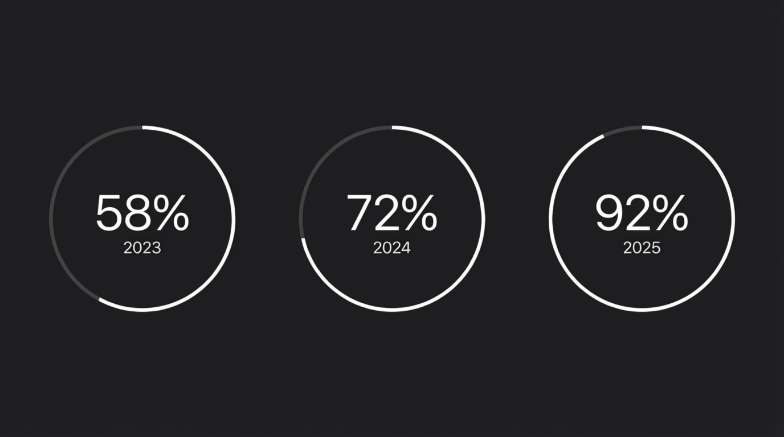
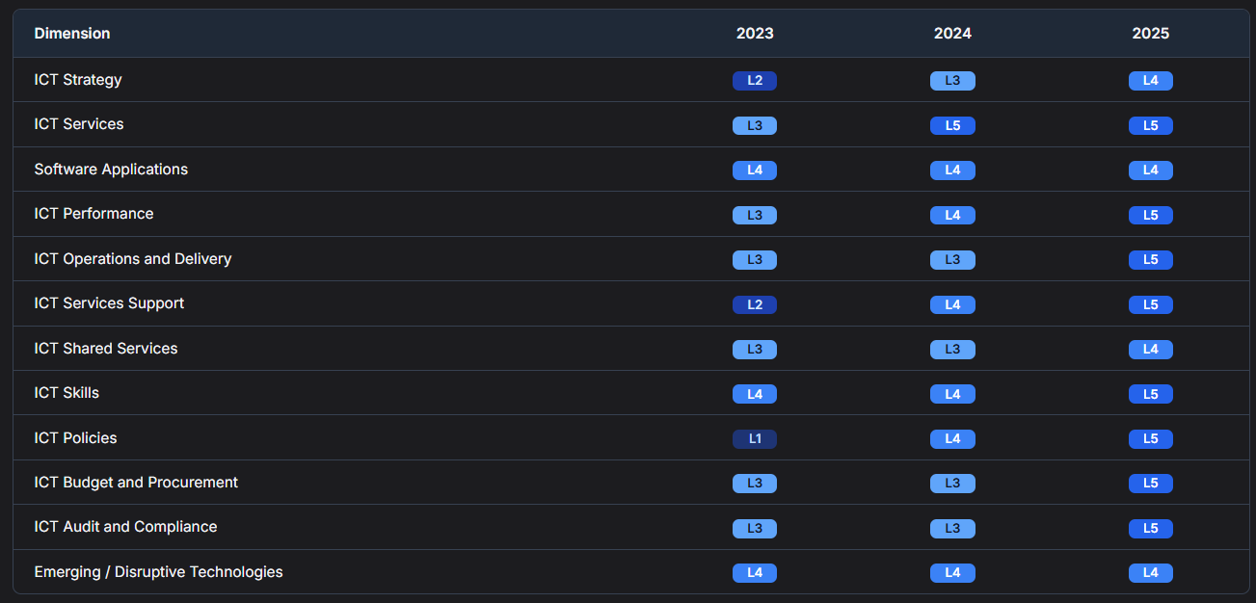
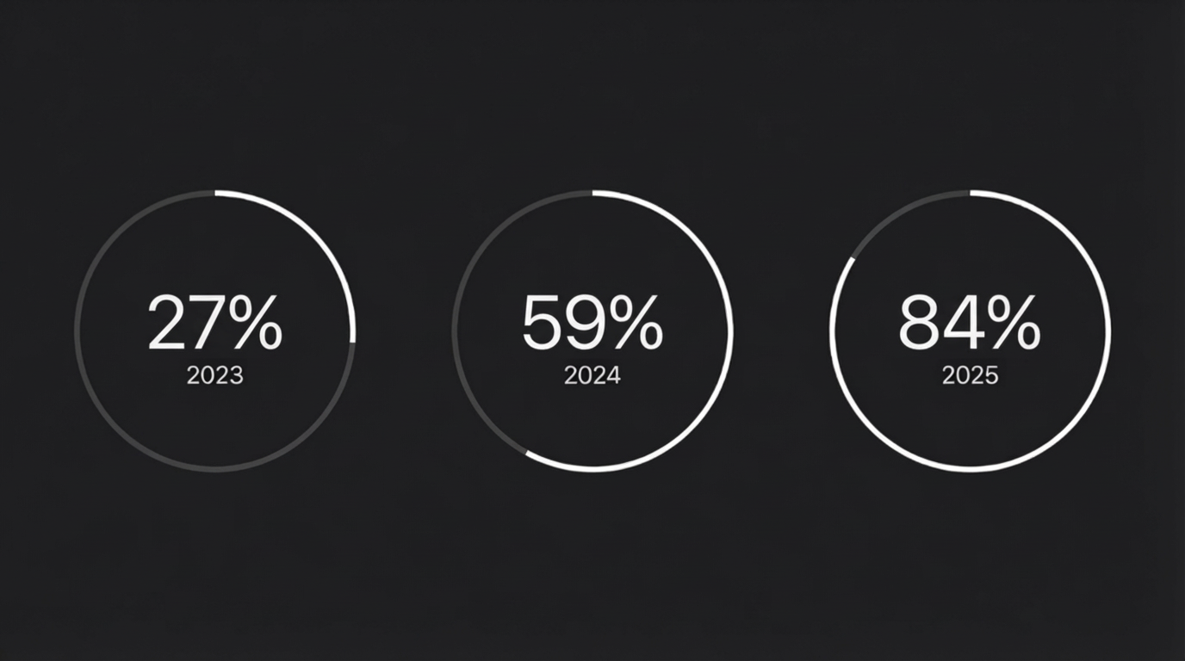
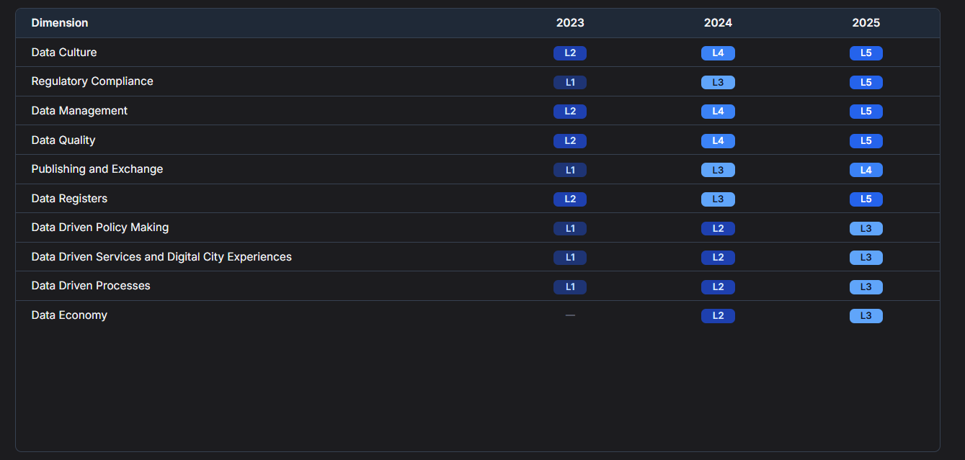
HIGHLIGHTS
DIGITAL TRANSFORMATION
FUTURE LEADERSHIP
DIGITIZED SERVICES
Ensuring seamless and secure implementation to deliver critical projects on-time
DIGITAL MATURITY ASSESSMENT
ICT Maturity
Data Maturity
NA
L3
* Data Economy levels range from L1 to L3

Slide 4


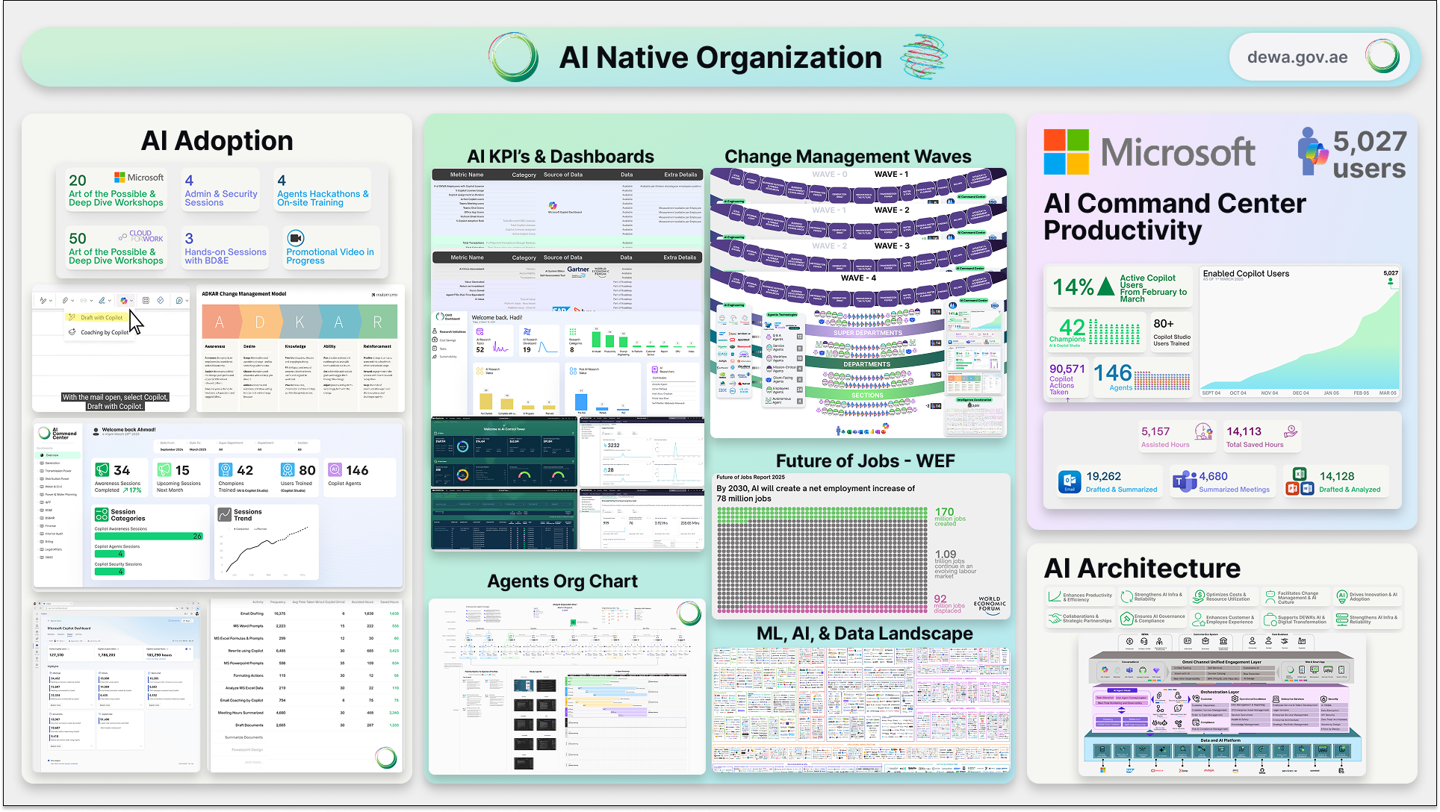

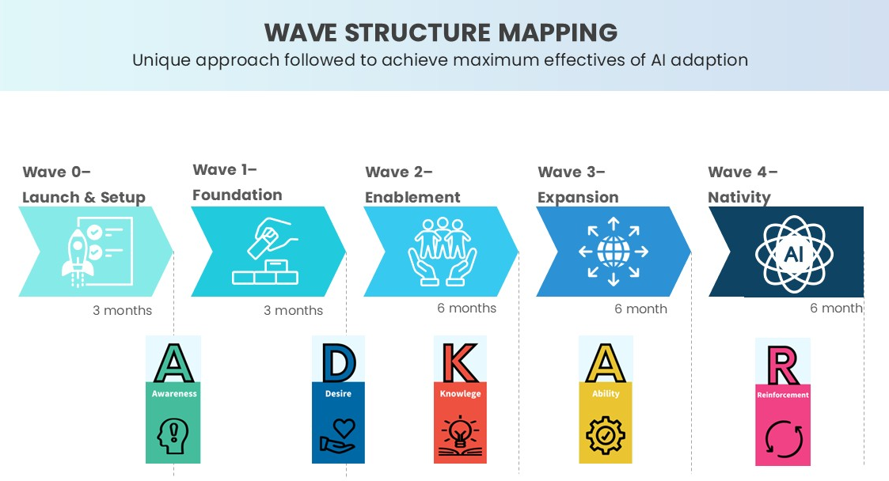

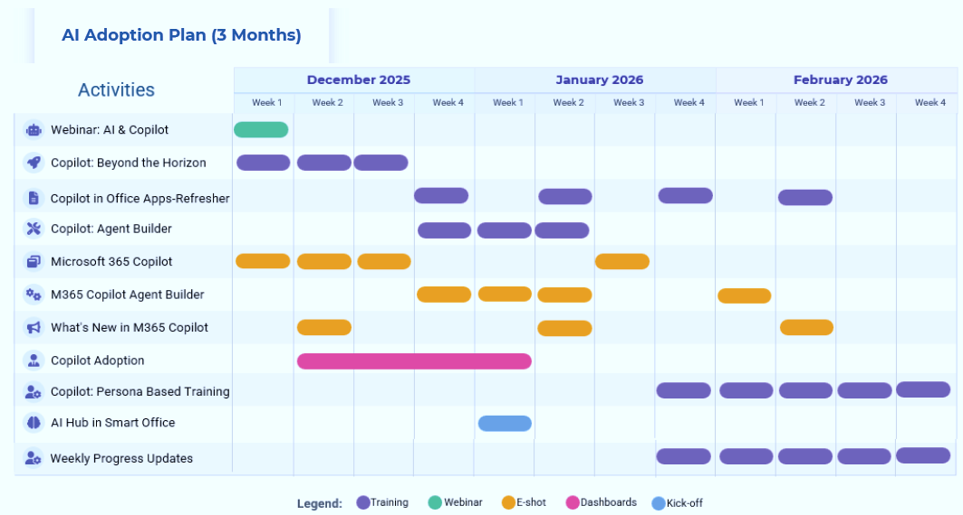
HIGHLIGHTS
DIGITAL TRANSFORMATION
FUTURE LEADERSHIP
Artificial Intelligence
122
95.29%
Adoption Rate
56 M
Productivity value
Divisional
AI Champions
8,621
+1.6 M
Copilot Actions Taken
+162,000
Total Saved Hours
+640
Live Copilot Agents
247
Divisional
AI Enablers
+12
AICC Dashboards
Change Management Waves
DEWA AI Academy
GitHub Copilot Hackathon conducted for +250 DEWA Developers
Wave 0 | Launch & Setup
Wave 1 | Foundation
Wave 2 | Enablement
Wave 3 | Expansion
Wave 4 | Wave Nativity
Engaged with 5 leading universities and learning institutes to establish the DEWA AI Academy, aimed at upskilling DEWA staff with advanced AI technologies and future-ready skills
+80 Training session delivered
across divisions with 92.5% satisfaction rate in Q1
AI Adoption with Digital DEWA
Demand to Delivery AI demands process activation
.
The D2D process has been updated to better support AI initiatives by introducing an upfront feasibility and readiness assessment during demand intake.

Slide 5





HIGHLIGHTS
DIGITAL TRANSFORMATION
FUTURE LEADERSHIP
Artificial Intelligence
AI Technology Partnerships Exploration
Google AI Tools
Agent space licenses secured for agent-based exploration
NotebookLM leveraged for knowledge transformation
DEWA AI-OS
MICROSOFT
Monthly Copilot enablement webinars
Introduction of default & custom agents
Driving adoption through AI Champions network
Positioned as Copilot Frontier organization
DEWA AIOS App launched on ChatGPT (Feb 2026) first government & utility globally
Phase 1: Core customer services released
Phase 2: Arabic enablement with more than 22 services expansion
World Economic Fourm
Preparation for WEF Lighthouse Program participation
Alignment with global AI and digital benchmarks
DELL Technologies
Engagement with core operational divisions
Exploration of AI use cases in OT environments
Focus on performance, reliability, and efficiency
Dubai AI Week (DCAI)
DEWA selected as strategic partner
Platform to showcase AI leadership and initiatives

Slide 6
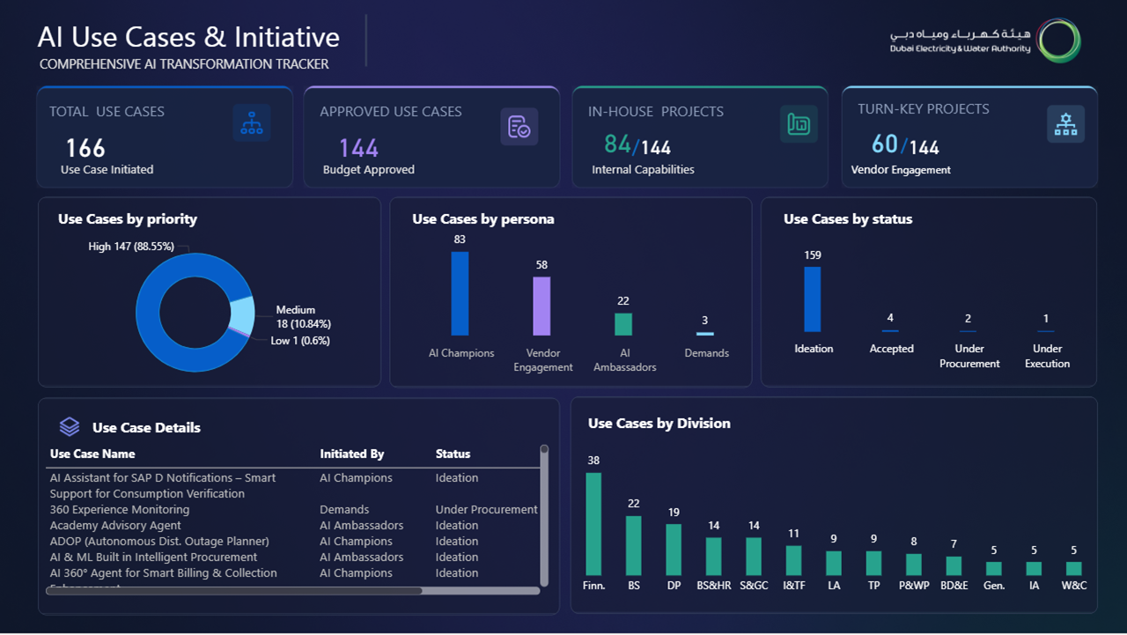
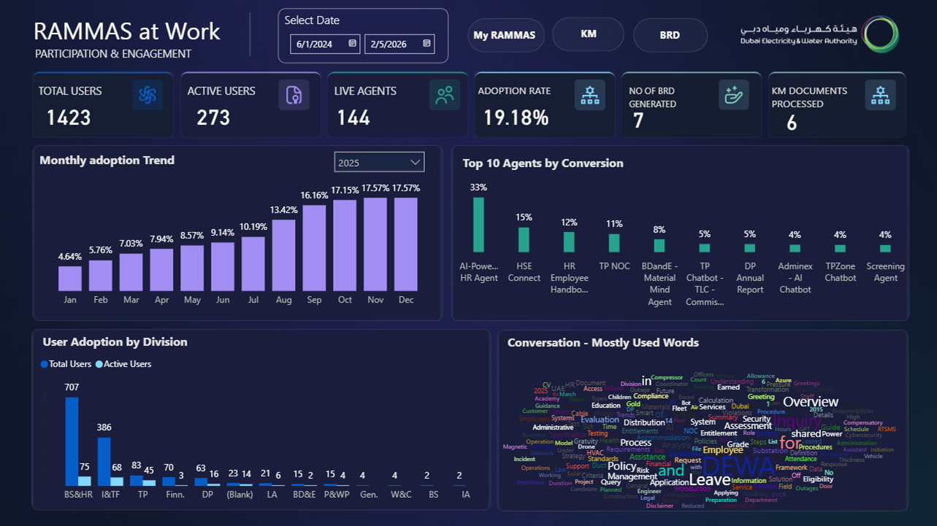
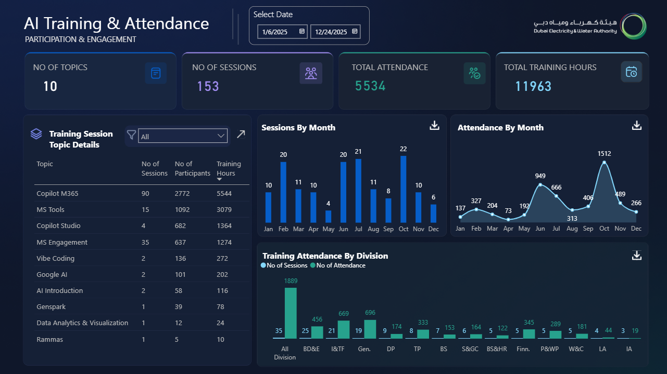
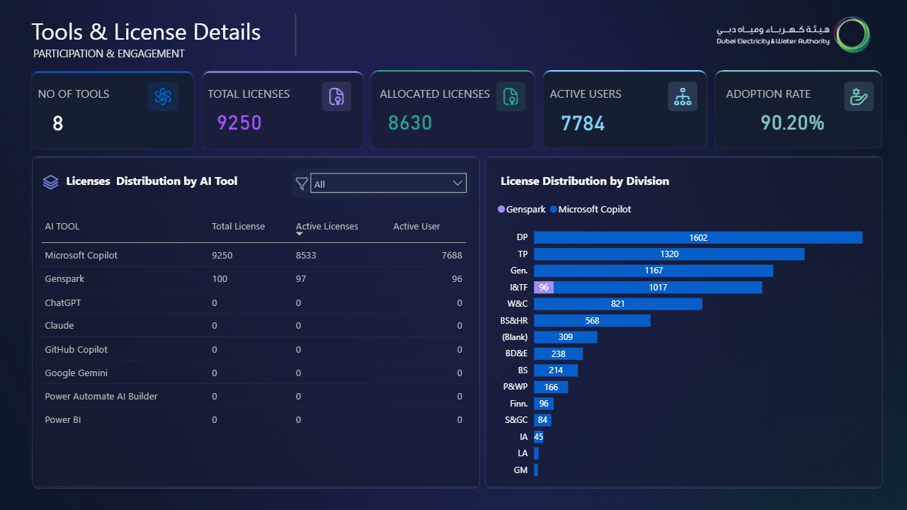
HIGHLIGHTS
DIGITAL TRANSFORMATION
FUTURE LEADERSHIP
AI Center of Excellence
Center of Excellence
.
It’s the platform is been initiated, providing a comprehensive view of the AI Adoption department’s progress and performance through KPI-driven and data-level dashboards.
Transformational Impact Across the Organization
Enterprise Visibility
Decision Speed
+12
Dashboards
+70%
Faster Insights
Unified KPI View Across Organization (UAT + Live)
Reduced Time to Decision-Making
Process Efficiency
Productivity Gains
+60%
Reduction
+30%
Improvement
Manual Reporting Automated
Faster Execution & Output
KPI Governance
Adoption & Reach
+90%
Standardized
AI Adoption Office
Aligned Metrics Across Functions
Organization-wide Engagement

Slide 7

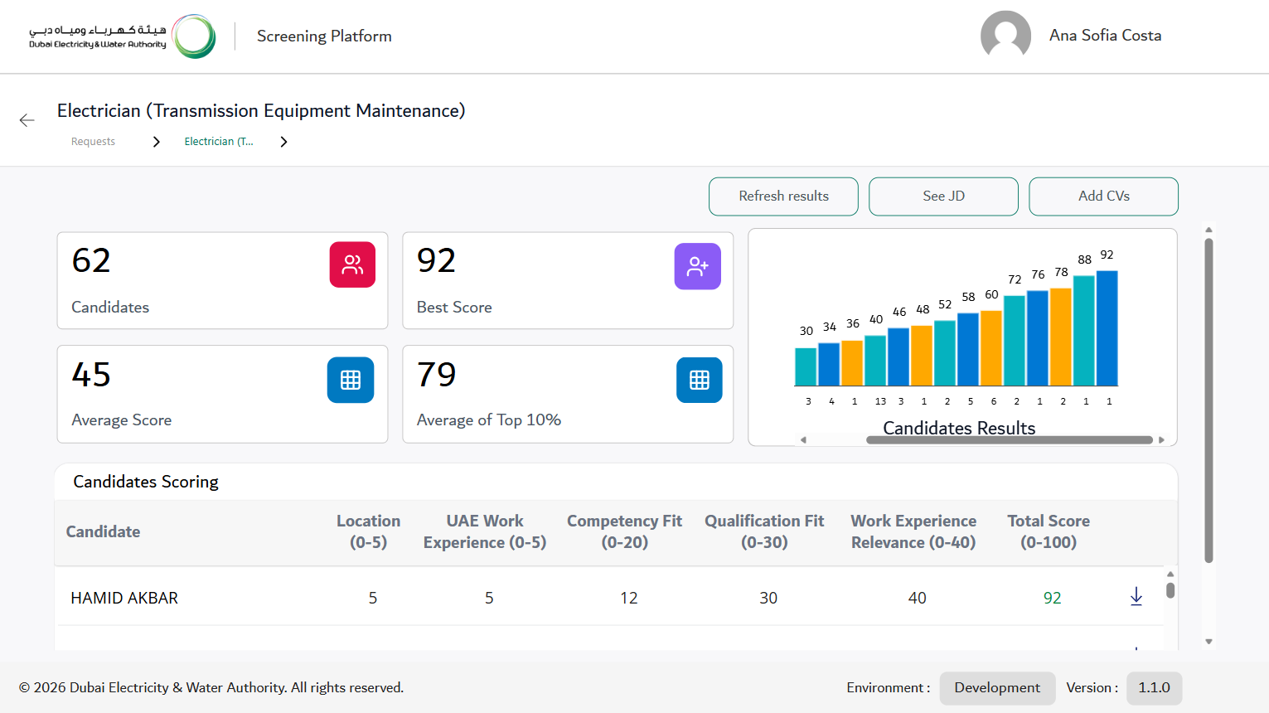

HIGHLIGHTS
DIGITAL TRANSFORMATION
FUTURE LEADERSHIP
Autonomous HR candidate Screening and Scoring Ai Agent
Strategic use of Agentic AI to modernize recruitment by accelerating hiring decisions and improving workforce quality through objective, data‑driven candidate matching and scoring.
Hours Saved per Year
Average Time to Complete Screening per Vacancy
Application Overview
↓ 99%
↓ 98%
740h
7h
3h
3 min
BASELINE
AI VALUE
BASELINE
AI VALUE
Average Time to
Process a CV
↓ 99%
180s
2s
BASELINE
AI VALUE

Slide 8
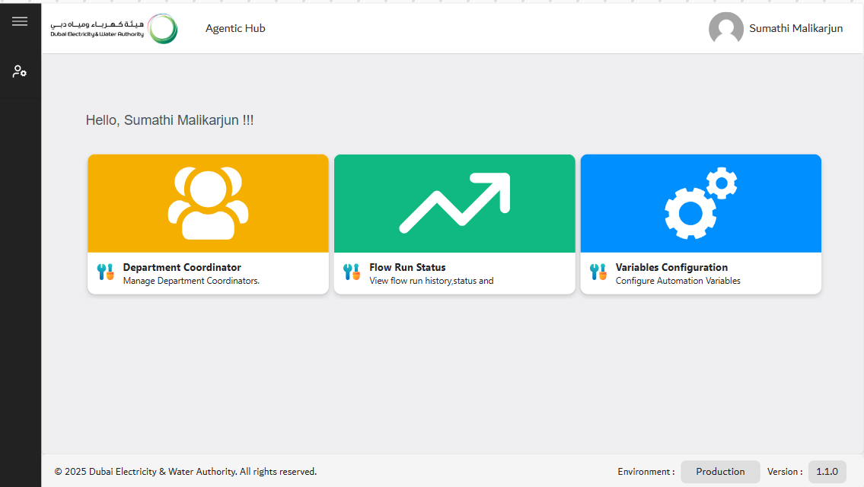

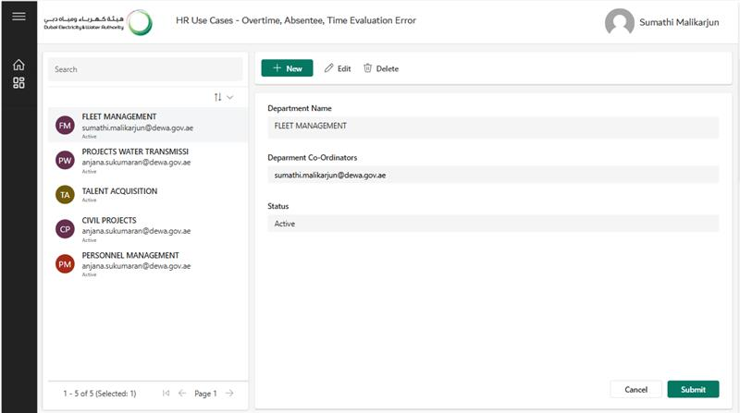
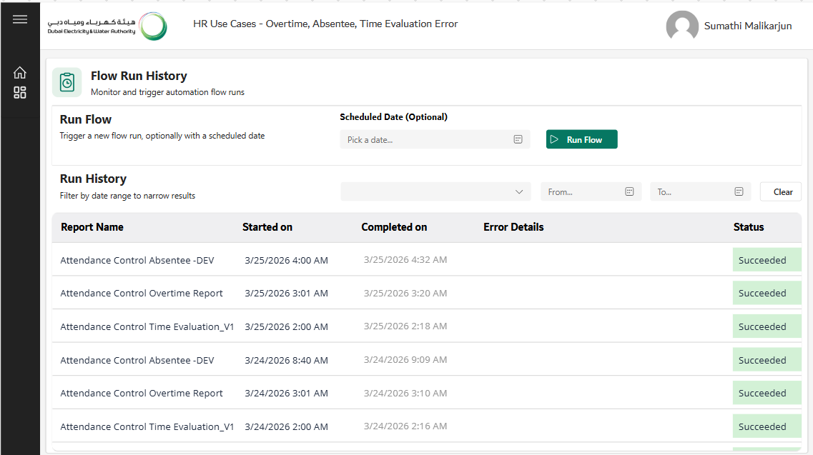

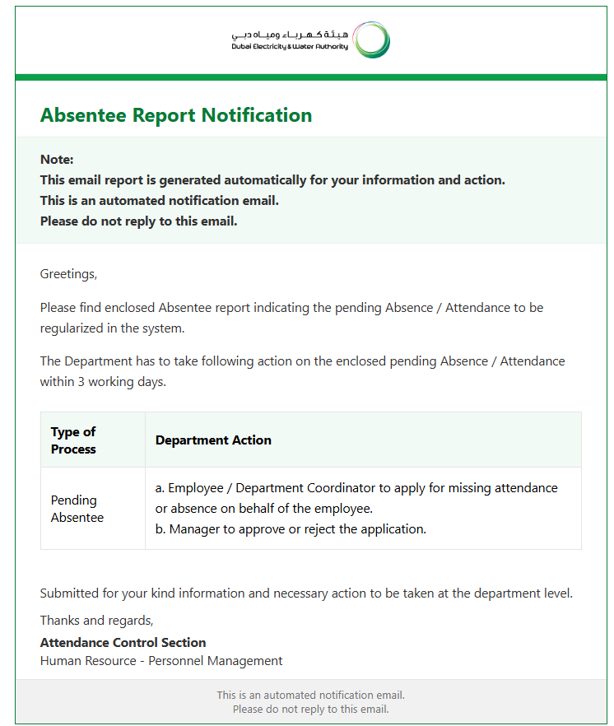
HIGHLIGHTS
DIGITAL TRANSFORMATION
FUTURE LEADERSHIP
Autonomous HR Attendance Control Ai Agent
AI‑driven Agent of SAP HR attendance reports, reducing manual effort and accelerating accurate reporting across all DEWA’s divisions & departments by generating and validating HR Absentee report, Time Evaluation Report and Overtime Report.
Process Automation
↑ 100%
80
100
BASELINE
AI VALUE
Happiness Rate
Average Processing Time
↑ 15%
↓ 100%
70%
85%
3-4h/w
0 min
BASELINE
AI VALUE
BASELINE
AI VALUE
Notes:
We have developed an AI Agent to automate HR attendance reporting, significantly improving efficiency, accuracy, and turnaround time for the Attendance Control team.
The AI Agent securely logs into SAP and automatically generates key HR attendance reports, including:
Absenteeism Reports
Time Evaluation Reports
Overtime Reports
Before distribution, the agent validates the data to ensure accuracy and consistency. Once validated, the reports are automatically shared with all DEWA coordinators individually, ensuring the right information reaches the right stakeholders without manual effort.
This solution eliminates repetitive manual work, reduces human error, and saves substantial time for the Attendance Control team, allowing them to focus on higher‑value HR activities. It also ensures timely, standardized, and reliable reporting across the organization.

Slide 9
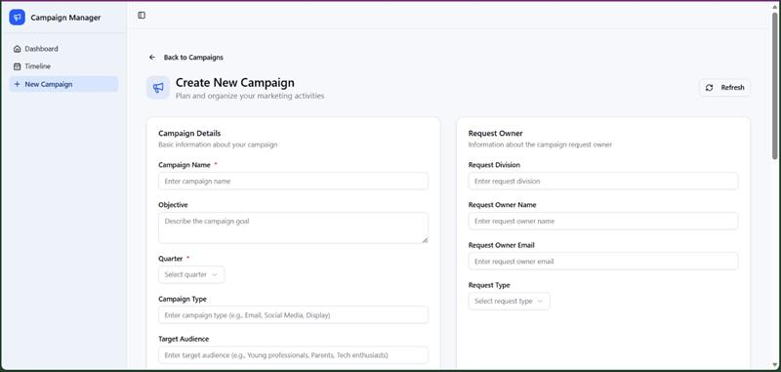
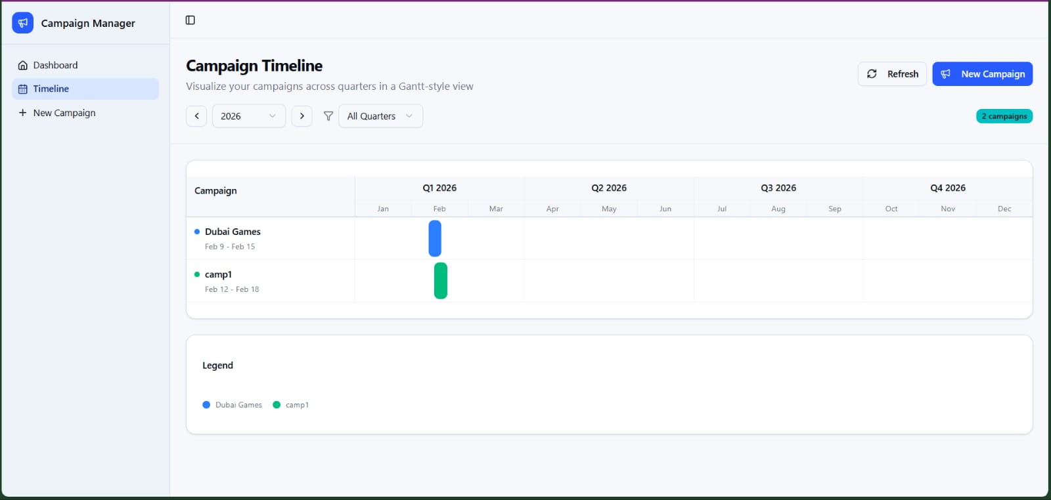
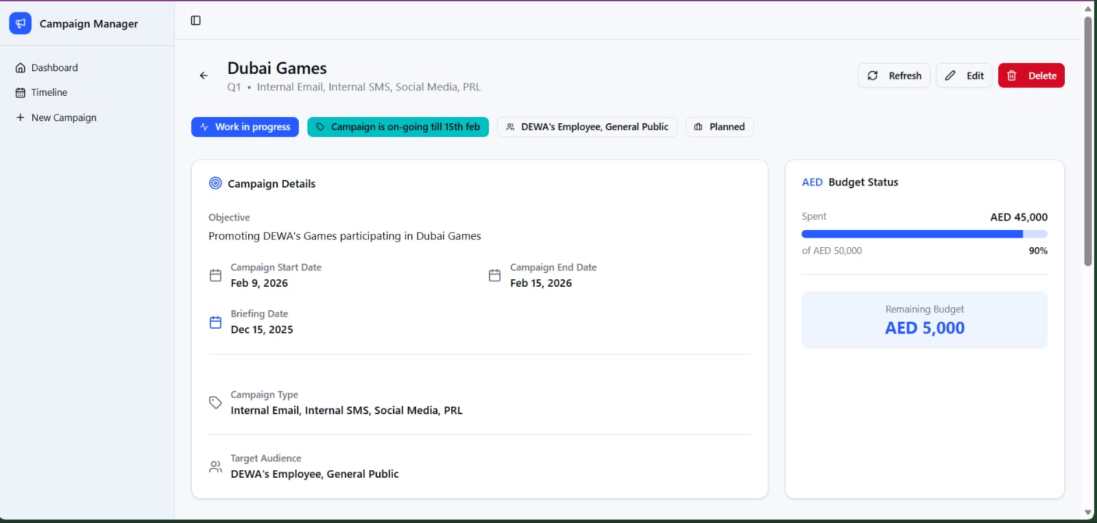
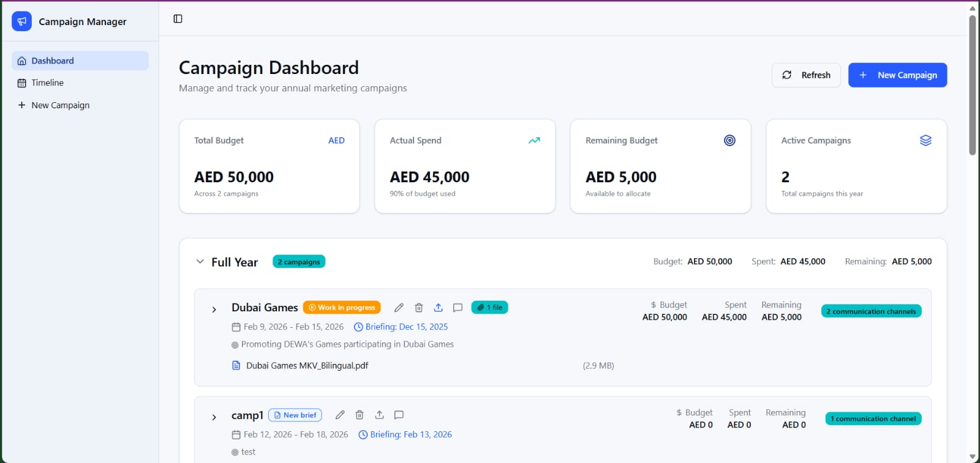
HIGHLIGHTS
DIGITAL TRANSFORMATION
FUTURE LEADERSHIP
S&GC Marketing Tracker App
Marketing Tracker application help marketing teams plan, organize, and manage campaigns and sub-campaigns efficiently
Efficiency Improvement
↑ 100%
User Satisfaction Score
Average Processing Time
↑ 15%
↓ 90%
70%
85%
2-3h
5 min
BASELINE
AI VALUE
BASELINE
AI VALUE

Slide 10










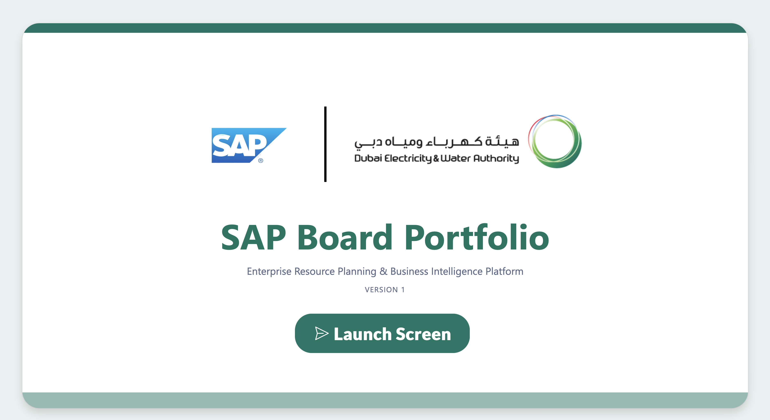

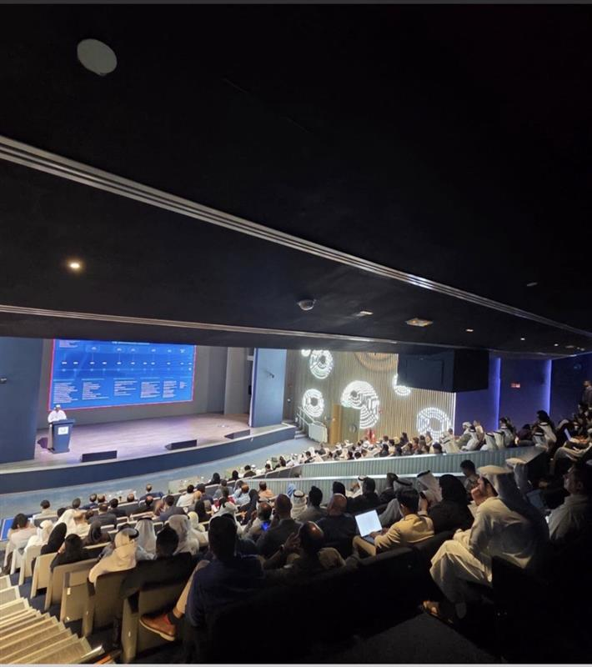


HIGHLIGHTS
DIGITAL TRANSFORMATION
FUTURE LEADERSHIP
DIGITIZED SERVICES
Ensuring seamless and secure implementation to deliver critical projects on-time
SAP Board Formation & Key Achievement
Formation
Purpose
Strategic Pillars
September 30, 2025
🔹
Centralized governance for DEWA's SAP ecosystem
🔹
Alignment with corporate strategy and future technologies
AI-Driven
Transformation
Cloud
Modernization
Strategic
Partnership
Portfolio
Governance
🔹
Drive innovation across AI and cloud
~727,500 USD
SAP Board Members
Secured through SAP Value Acceleration Services
Rajab
Albloushi
Lead
Saif
Alsuwaidi
Deputy
Amina
Abu Hamra
Atif
Waqar
Fatma
Albloushi
Khaled
Alshehi
Samir
Labacci
Ashish
Argawal
Atif
Sharif
Integration Suite, AI Advisory, LeanIX jumpstart
Savings
Key Achievements
Next Steps – SAP Business AI Advisory & Assessment Program
Phase 1
AI Discovery & LOB AI Workshops
Apr
Planning
Foundation
Achievement 1
Order Form / SOW Signature
Mar–Apr
In Process
Launch of SAP Board Portfolio Application
Phase 2
Fiori Readiness & UX Strategy/Roadmap
Apr–June
Not Started
Readiness
Avg. Processing Time ↓ 1–2 Hrs → 3 Min | 30% Initiatives Posted
Joule Readiness Service
Apr–May
Not Started
BTP & AI Governance Service
Apr–May
Not Started
AI Assessment & Readiness (S/4HANA)
Apr–July
Not Started
Phase 3
SAP Business AI Strategy & Advisory
Apr–Oct
Not Started
Achievement 2
Strategy
Phase 4
Unified Joule Architecture Prep & Sign-off
Apr–June
Not Started
Successful delivery of DEWA SAP AI Enablement Workshop
Execution
Joule Activation (Non-Prod + FT + UAT)
June–Aug
Not Started
31 March 2026 | 272+ attendees
Joule Activation (Prod)
July–Sept
Not Started
Phase 5
AI Services Enablement
May–July
Not Started
Enablement
AI CoE Setup Services
Apr–Sept
Not Started

Slide 11
HIGHLIGHTS
DIGITAL TRANSFORMATION
FUTURE LEADERSHIP
DIGITIZED SERVICES
Ensuring seamless and secure implementation to deliver critical projects on-time
Q3-q4/2025
Q1/2026
57
17
AED 2,650,000
58
4
AED 1,125,000
Total number of Projects
Completed Projects
Total cost of
Completed Projects
Completed Projects
Total number of Projects
Total cost of
Completed Projects
* Turnkey Projects
* Turnkey Projects
Unified Channel - Dubai Now Project | 360 Services - Request for Water Network Modification
SAP S4HANA-2023 Upgrade | 360 Services - Request for Electricity Network Modification
Digital Mailroom Project – Transmission Power* | 360 Services - Getting Electricity Supply for Fit-Out Connection
SAP GRC-Risk Management Dashboards | 360 Services - Getting Solar Permits and Connection
Leased vehicle process automation* | 360 Services - Getting Electricity Supply for Tents
DEWA & Digital DEWA Accounting Integration | Migration and Upgradation of Physical Servers including HA & DR
Smart Response Solution for SAP* | Website Accessibility Tools For People Of Determination
GIS Data Modelling and visualization for DEWA | GIS Hub Portal Enhancement
Project Recovery Process for Capital Projects
Process Automations- for Water & Civil - Projects Water Transmission
Mu’asherat Approval Delegation*
ANPR System Implementation*
Notes:
Khalid Bahlooq

Slide 12
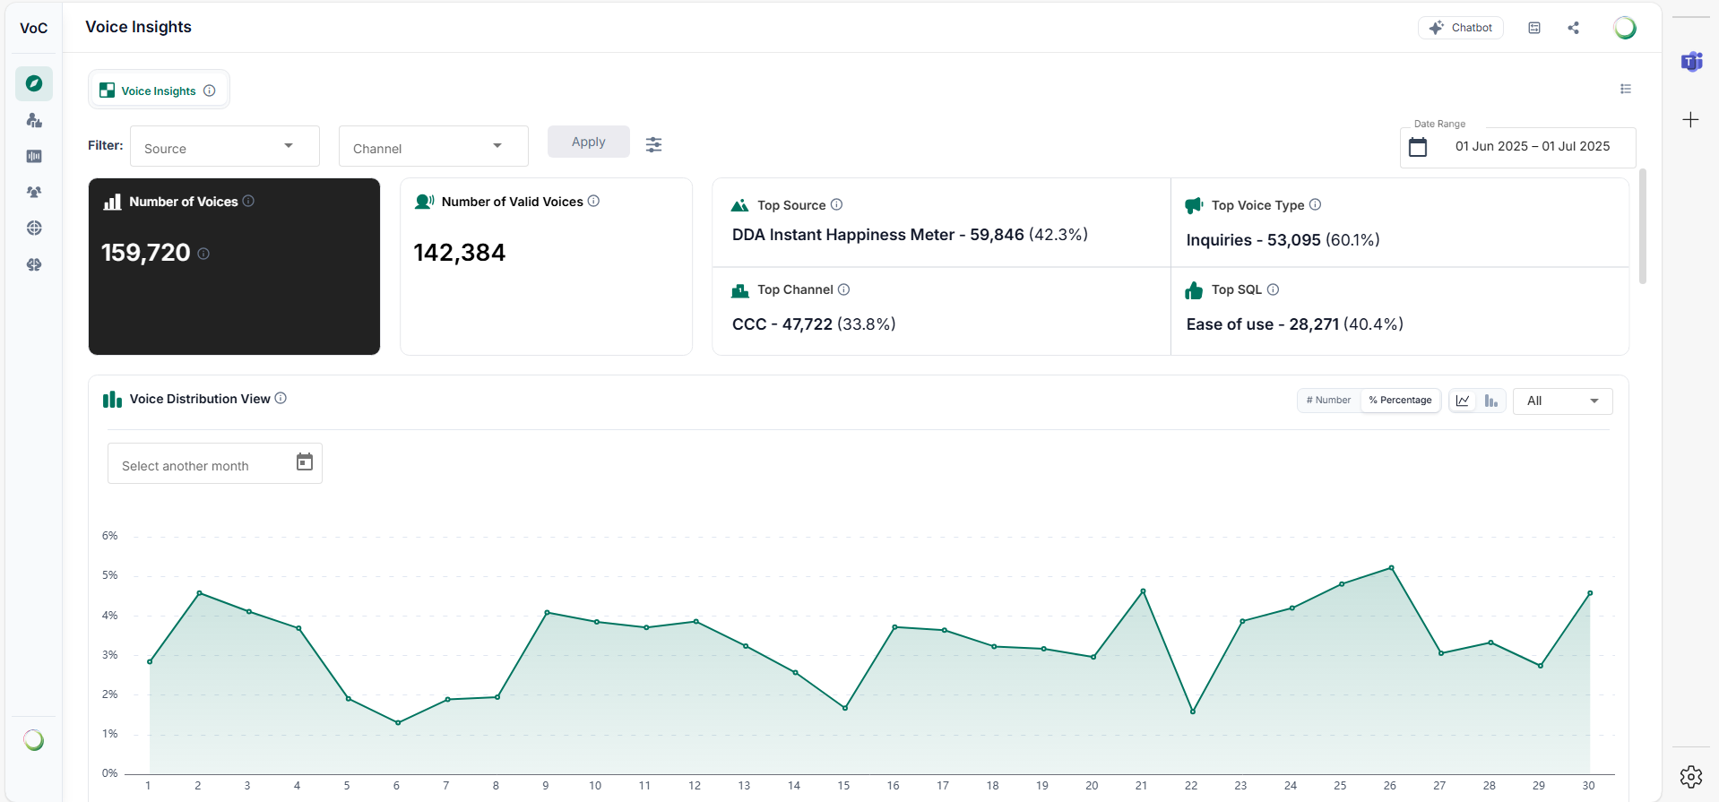
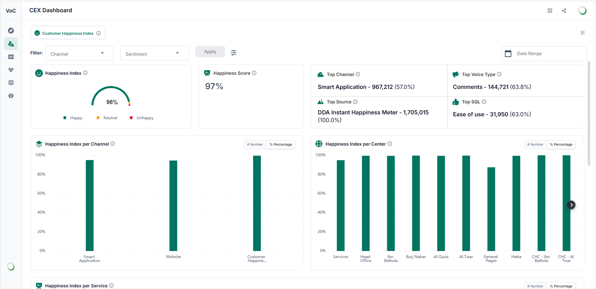
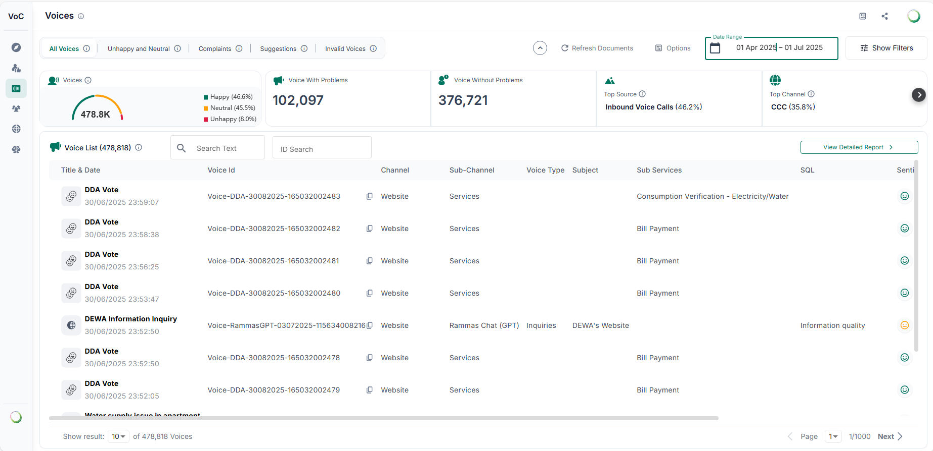
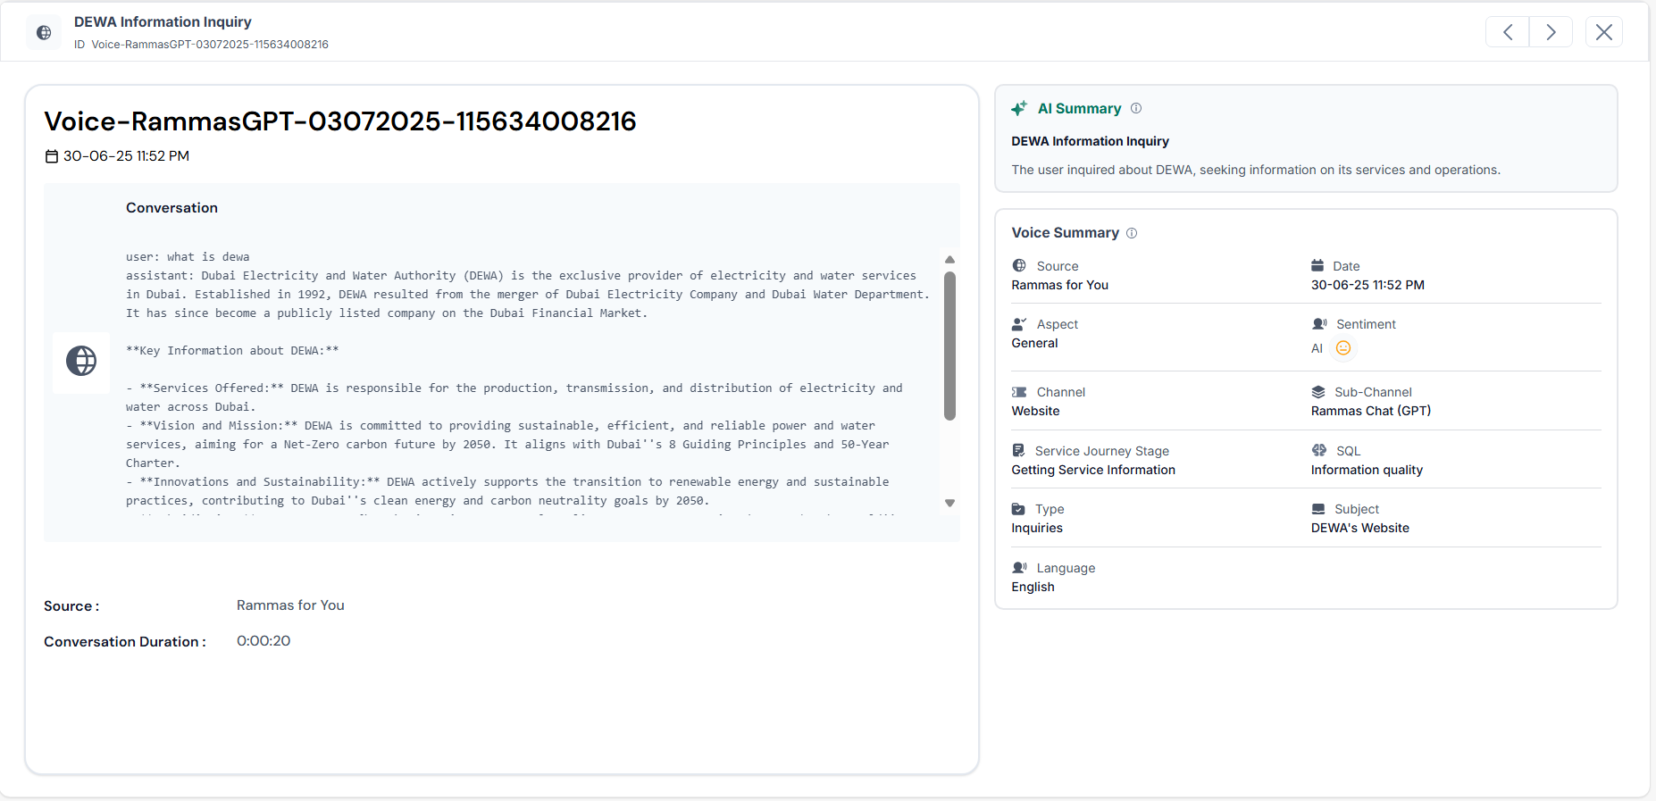



HIGHLIGHTS
DIGITAL TRANSFORMATION
FUTURE LEADERSHIP
DIGITIZED SERVICES
Ensuring seamless and secure implementation to deliver critical projects on-time
Voice Of Customer Automation
In Progress 75%
Execution Phase - Start: March 2025 | End: April 2026
It automates and enhances the current internal process of collecting and analyzing customer feedback from various internal and external data sources. The system aims to centralize reporting, integrate with existing tools and provide dynamic, actionable insights to improve customer services, responsiveness and enhance overall customer experience.
28
Channels
85.79%
Accuracy of 3 months data
6.7M
Customer Voices
External Endorsements
Based on Microsoft’s review, the VOC solution demonstrates a strong, scalable GenAI design with clear usability, effective workflows, and high potential to deliver actionable customer insights and measurable business impact.
Aligned with Gartner’s guidance on Voice of the Customer programs, the VOC framework demonstrates strong governance, measurable scoring mechanism, and a structured closed-loop approach to driving business outcomes.
McKinsey recognizes the VOC framework as a well-structured and transparent methodology with strong end-to-end traceability and a mature evaluation model aligned to business impact.
Notes:
Khalid Bahlooq

Slide 13
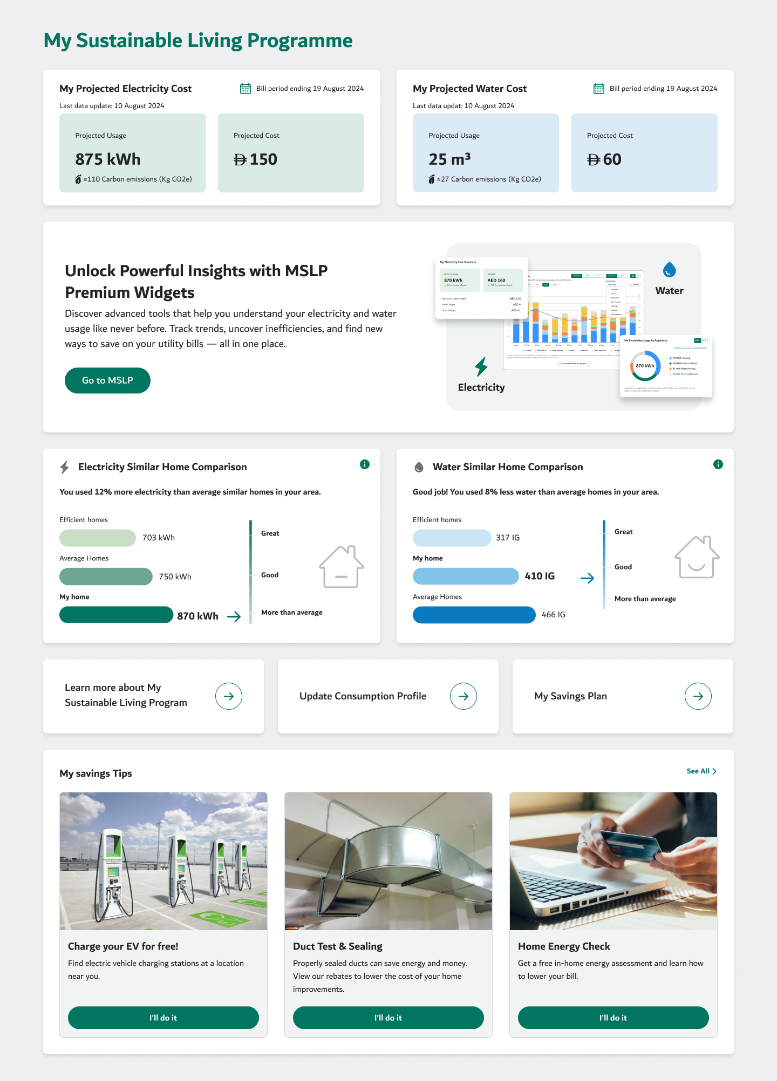
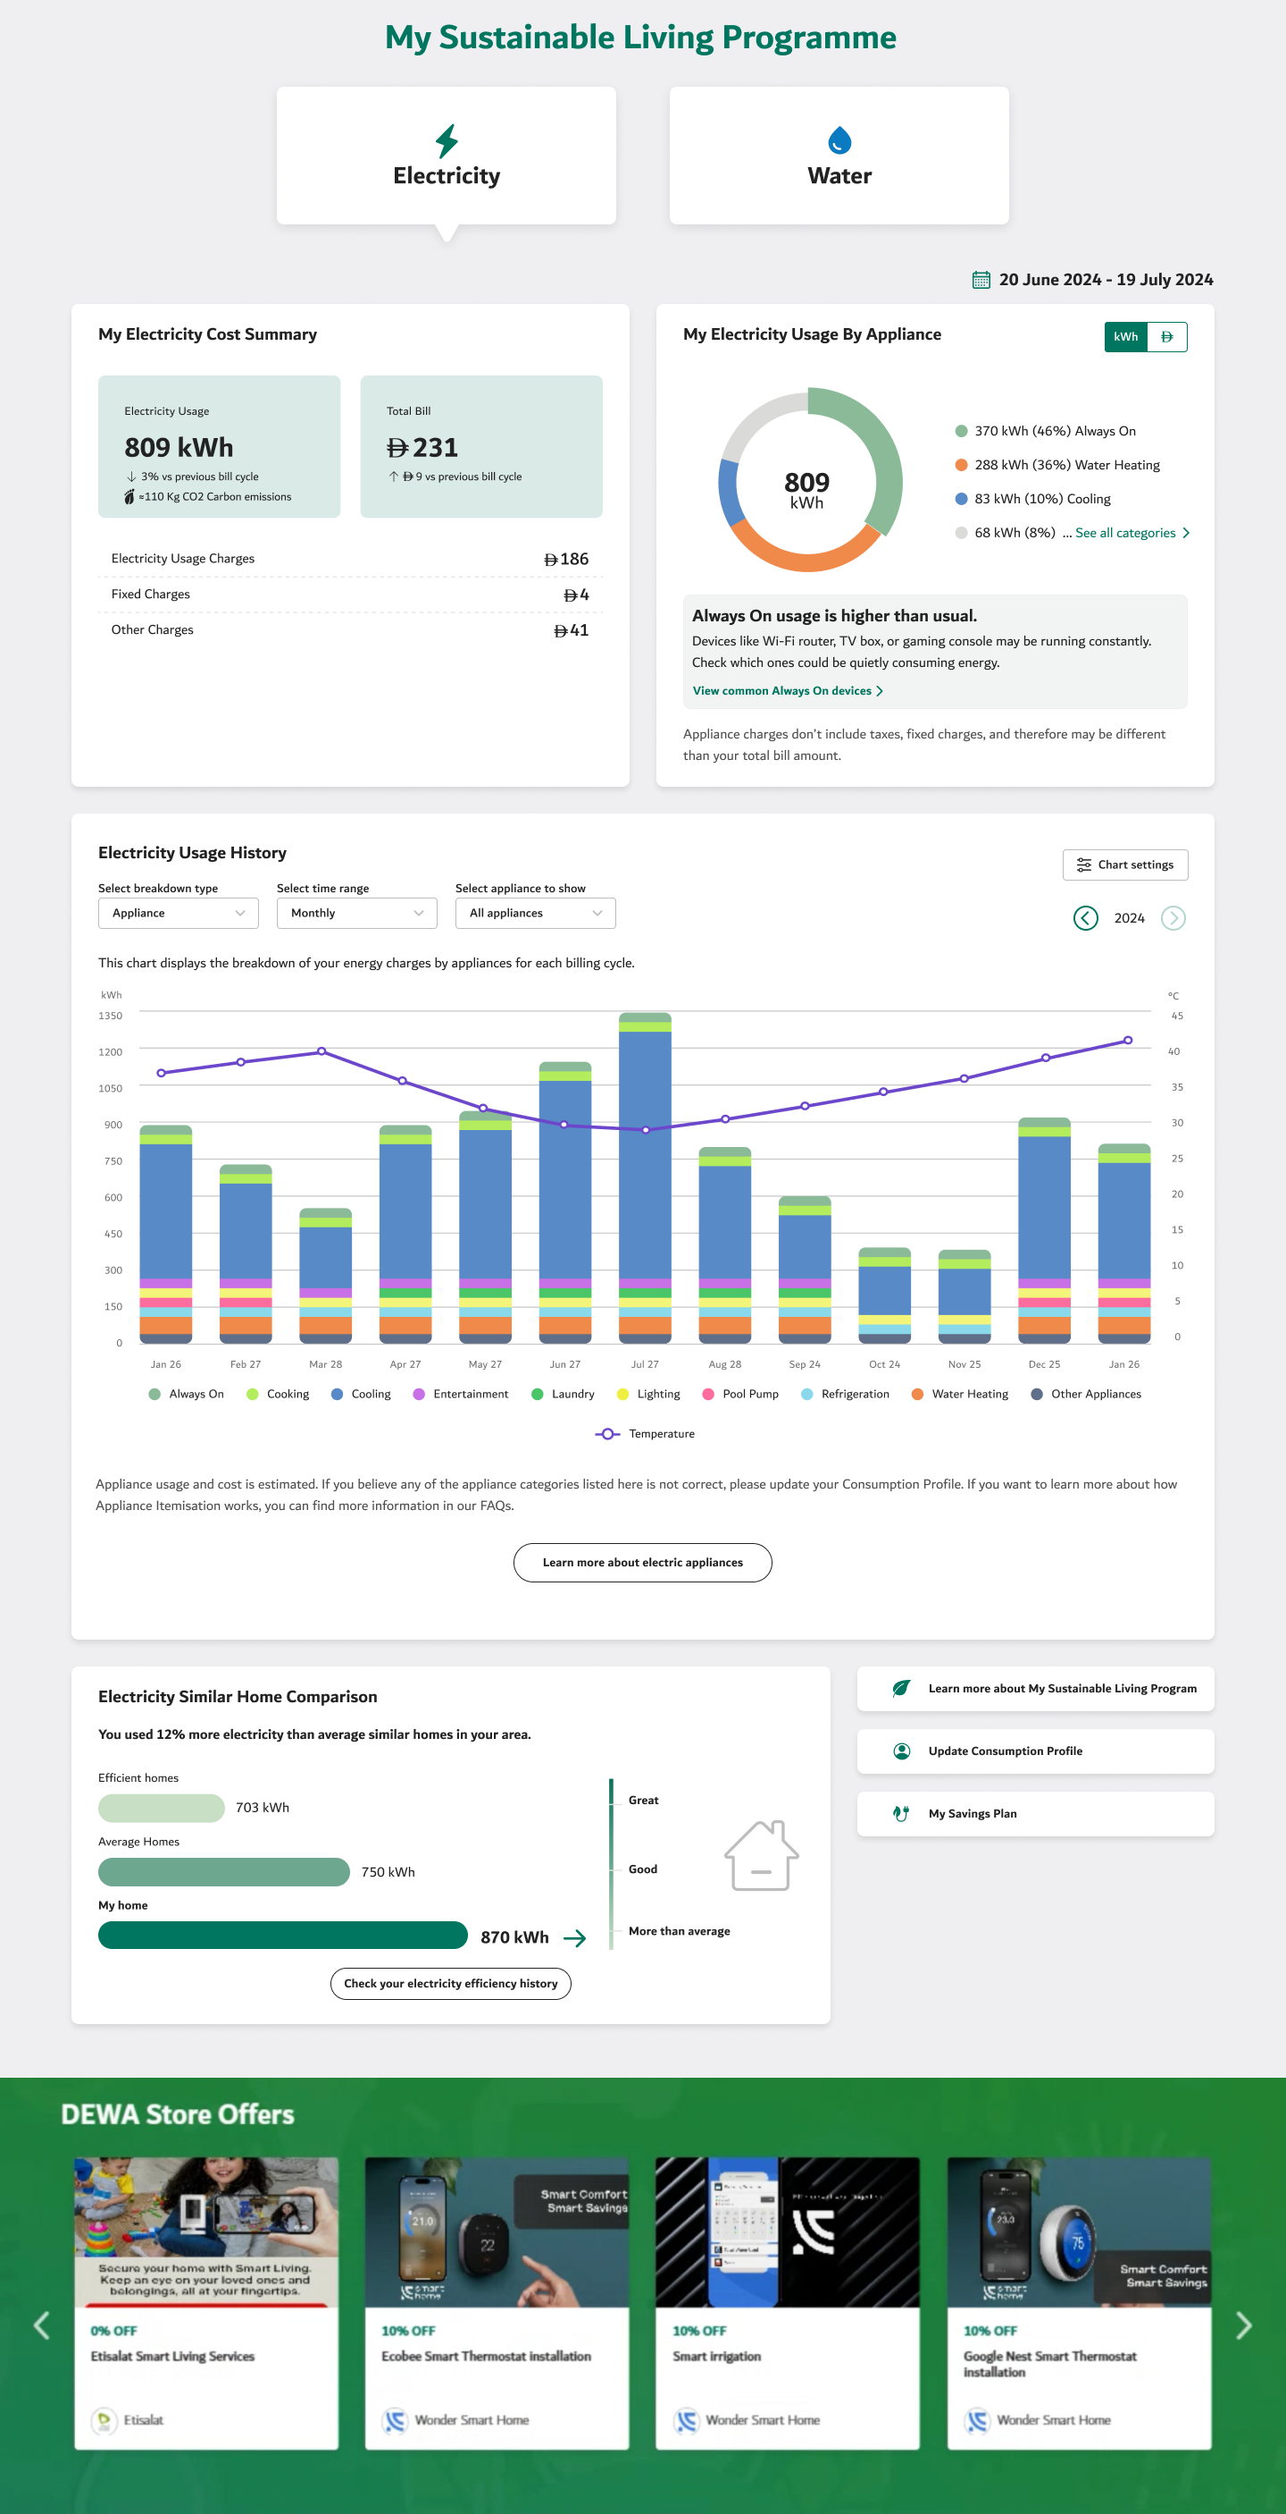



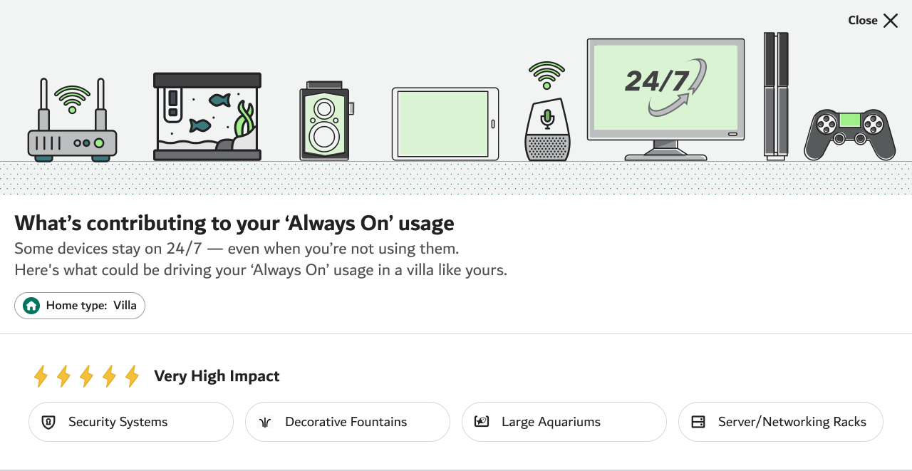
HIGHLIGHTS
DIGITAL TRANSFORMATION
FUTURE LEADERSHIP
DIGITIZED SERVICES
Ensuring seamless and secure implementation to deliver critical projects on-time
My Sustainable Living Program 2.0
In Progress 85%
Execution Phase - Start: April 2024 | End: May 2026
It empowers customers with data-driven insights into their electricity and water consumption - delivering a comprehensive and actionable view of resource consumption across DEWA channels.
Improved customer awareness
of consumption patterns
600,000+
Residential Customers
1.2M+
Personalized Insights
Delivered
1.2M+
Personalized Insights
Increased customer engagement
with sustainability features
Enhanced sustainability impact
supporting DEWA’s environmental goals
Subscription-based revenue model
for advanced sustainability features
2500+
Clusters used for Similar Home Comparison
12 6
12 6
Categories of appliances
Categories of appliances
Key Outcomes
Benchmarked leading sustainability platforms to define best-in-class experience.
Reviewed and optimized data-heavy interfaces to enhance clarity and usability.
Simplified complex insights to improve user understanding and decision-making.

Slide 14
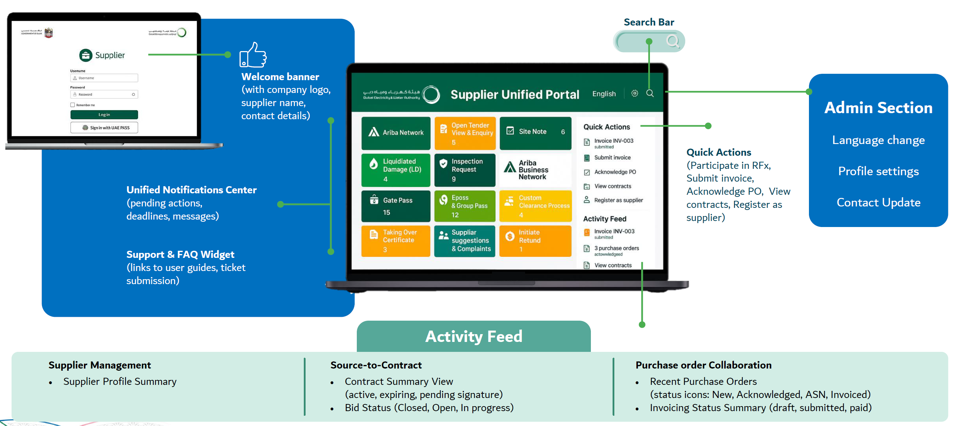
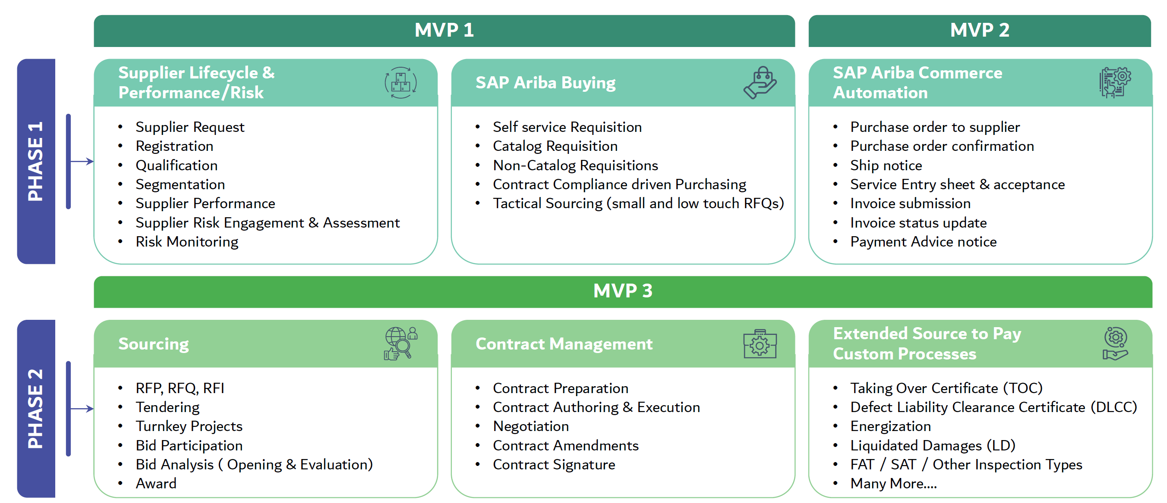
HIGHLIGHTS
DIGITAL TRANSFORMATION
FUTURE LEADERSHIP
DIGITIZED SERVICES
Ensuring seamless and secure implementation to deliver critical projects on-time
Abeer AlSharaf
SAP ARIBA Transformation
In Progress 5%
Execution Phase - Start: February 2026 | End: March 2028
It replaces all SAP SRM procurement processes to SAP Ariba, delivering a modern cloud‑based procurement environment with guided buying, advanced sourcing and contracting, enhanced supplier collaboration customer experience.
Notes:
Khalid Bahlooq

Slide 15
HIGHLIGHTS
DIGITAL TRANSFORMATION
FUTURE LEADERSHIP
Shurooq Almheiri
DIGITIZED SERVICES
Ensuring seamless and secure implementation to deliver critical projects on-time
Digital Experience
Testing Center of Excellence
Total DX Projects
AI Adoption
Total TCoE Projects
Releases Handled
Q1 2026
Q1 2026
Q1 2026
84
100%
85
488
AI Avg Time Saving
Total Test Cases Created
Total Automated Test Scenarios
AI Productivity Gain
Q1 2026
From 2022 till date
89%
≈170%
47,605
304
AI Cost Saving
AI Annual Resource Optimization Saving
Total Defects Identified
Critical/High Defects
Since July 2025
Q1 2026
Q1 2026
13.08M AED
2.6M AED
1,478
316
AI is integrated across all DX processes since July 2025
≈ 61M
AED ROI since the launch of TCoE (Jan 2023)

Slide 16
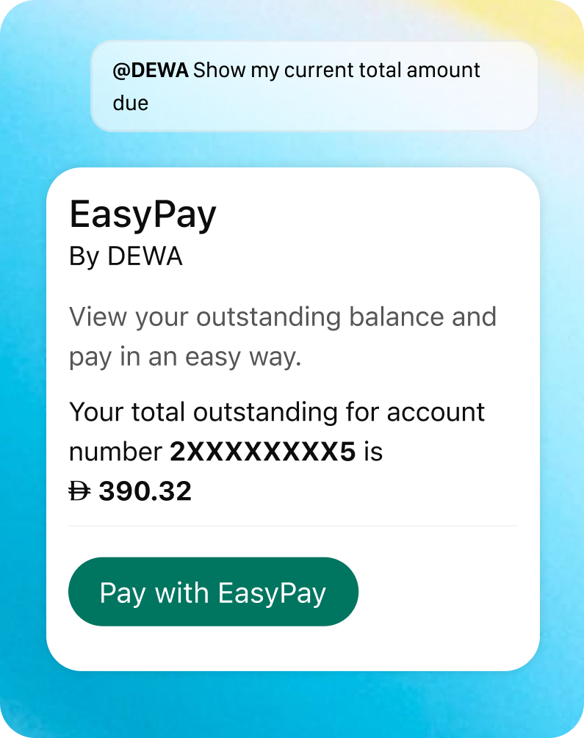
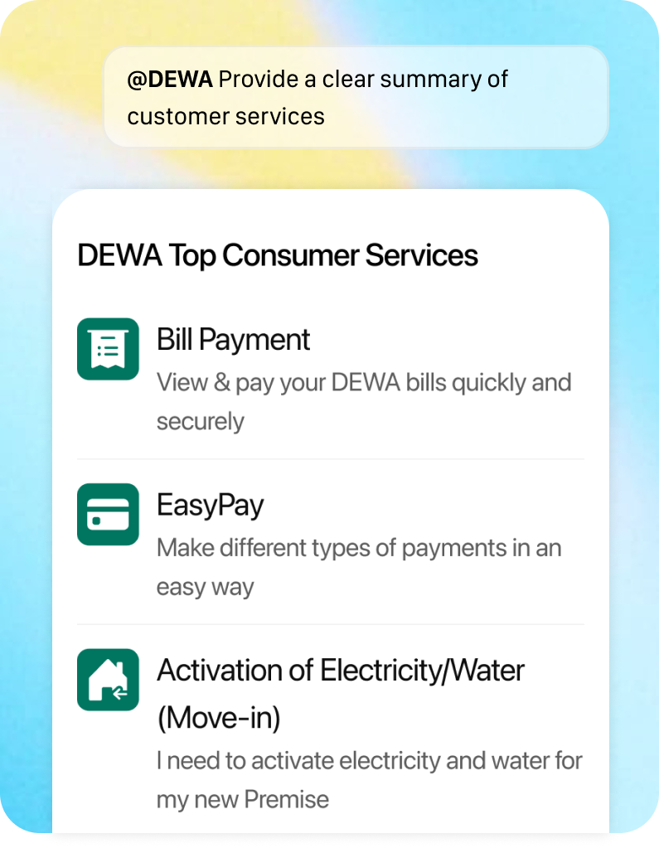
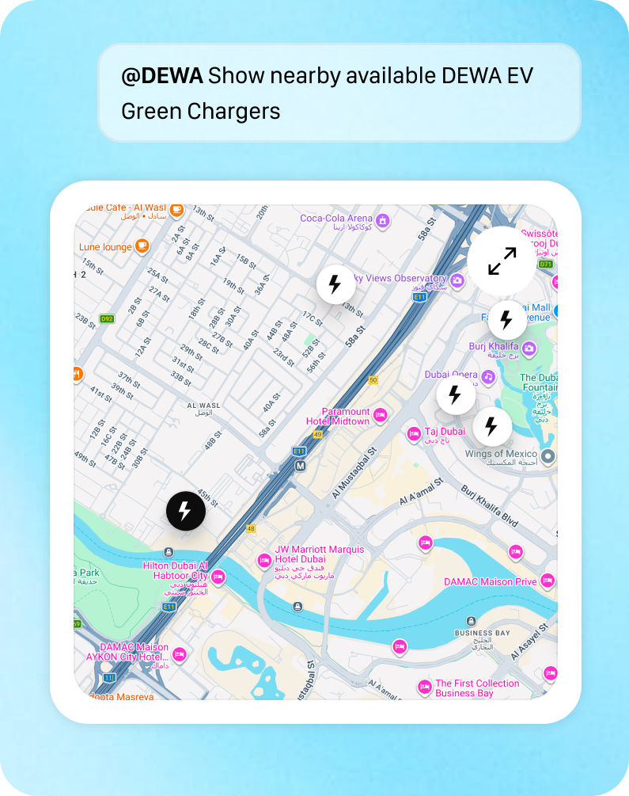



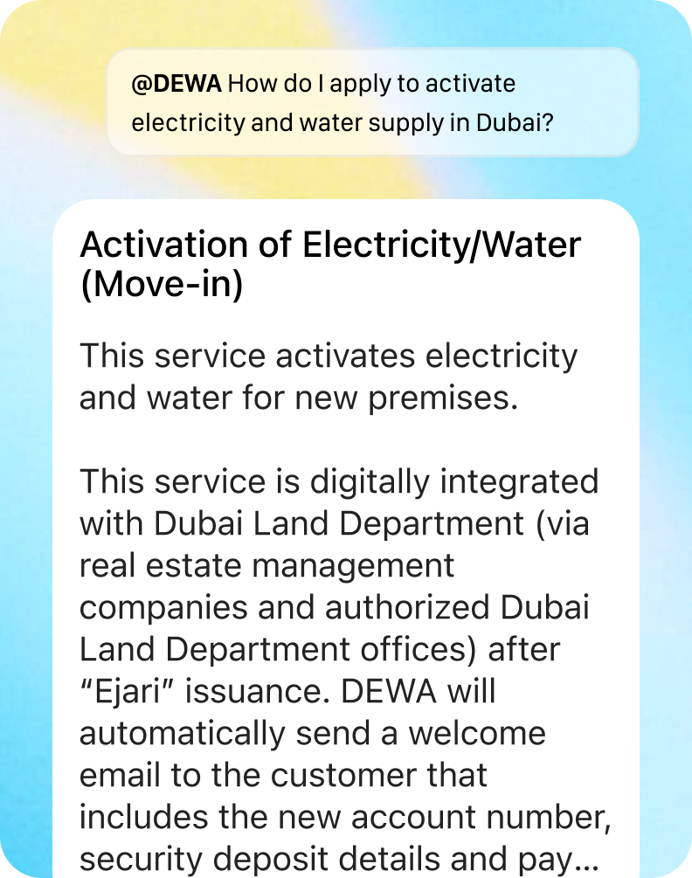
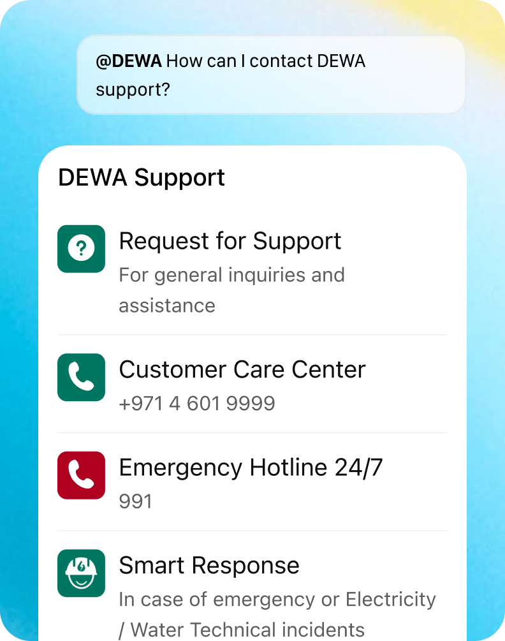
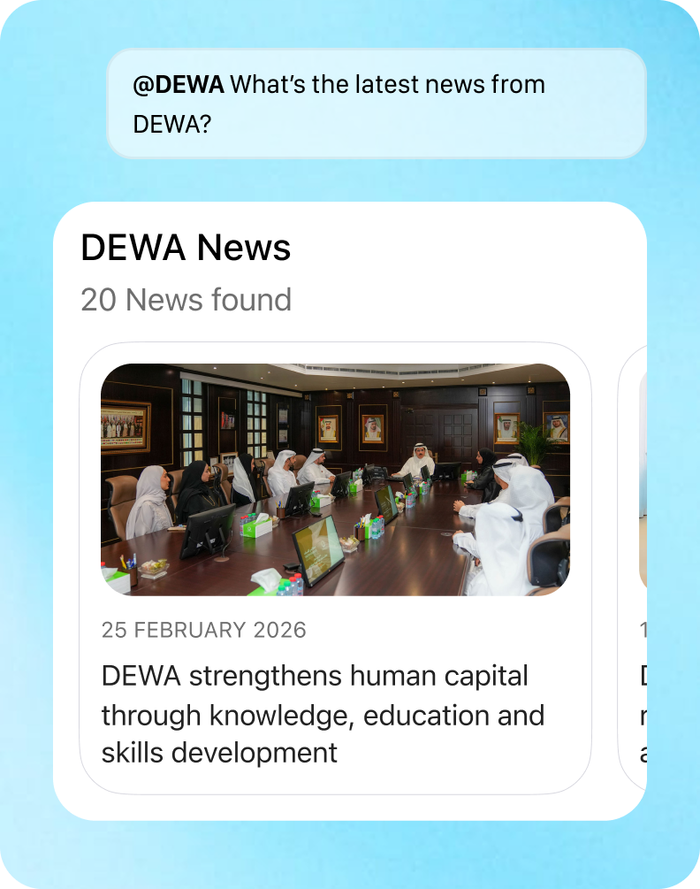
HIGHLIGHTS
DIGITAL TRANSFORMATION
FUTURE LEADERSHIP
Shurooq Almheiri
DIGITIZED SERVICES
Ensuring seamless and secure implementation to deliver critical projects on-time
AI OS: DEWA App in ChatGPT
Bill Inquiry
Services Discovery
DEWA Locations
The DEWA App in ChatGPT is part of the DEWA AI OS initiative, integrating DEWA services into a conversational, AI-powered interface that enables customers to interact using natural language.
~800M
-90%
1st
Weekly users reach from ChatGPT
Early-mover advantage
Reduction in service discovery effort
Service Description
Support Channels
DEWA News
Key Outcomes
Phase 1 is live
Defined strategy & high-value use cases through benchmarking.
Delivered an AI-driven experience aligned with OpenAI standards.
Ensured quality, launch success & executive alignment.
Delivered end-to-end testing across all ChatGPT modules.
Validated accuracy, security & integration across channels.
Ensured production readiness through defect resolution & validation.

Slide 17


HIGHLIGHTS
DIGITAL TRANSFORMATION
FUTURE LEADERSHIP
DIGITIZED SERVICES
Ensuring seamless and secure implementation to deliver critical projects on-time
Improved Customer Digital Experience
AI OS: DEWA App in ChatGPT
Investor Relations Revamp
Customer Profile Enhancements
Bill Inquiry
View Services
View Locations
Service Info.
Support
View News
My Sustainable Living Program 2.0
WETEX 2026 Improvements
Driving the Future of Electric Mobility
Empowering Solar Energy Experiences
Services & Digital Platforms
Charge Point Operator Portal (CPO)
Hosting & Receiving Accounts Setup
Clearance Certificate Revamp
Away Mode Revamp
Dubai Now: EV Card Replacement
Digital Correspondence (Builders)
Smart Supervision (Suppliers)
Smart Response – Live Tracking
Media Center Revamp
Generative AI Search
The Ideal Home Revamp
Green Pledge Revamp
Green Bill Improvements
Low Voltage (LV) Network
EV Fleet Management Portal (Electron)
Net Meter Activation

Slide 18


HIGHLIGHTS
DIGITAL TRANSFORMATION
FUTURE LEADERSHIP
Shurooq Almheiri
DIGITIZED SERVICES
Ensuring seamless and secure implementation to deliver critical projects on-time
Improved Employee Digital Experience
Al Shera’a App
Internal Platforms
Conducted a UX/UI audit of the Sheraa platform, identifying usability gaps, assessing alignment with DEWA standards, and providing actionable recommendations to enhance the experience.
Freejna 5 Revamp
ROMS Portal – Phase 2
GD Virtual Engineer AI
Demand Management (D2D)
Knowledge Management
Lighthouse Collaboration
Guest Wi-Fi Access
RASID
LIMS Cable Lab
Field One Application
Sustainability Word Search
Afkari
+140
UI/UX Findings Reported
Smart Office Improvements
Internal Dashboards
AI-Powered Smart Document
Android 16 Upgrade
IOS 26 Design Upgrade
Corporate Excellence
Marifa
Masharee Approval
Training Podcast
Excellence Hub Approvals
Self Service - Leave Application
HR Services Release 2
DEWA Locations
MD Dashboard Enhancements
AI Center of Excellence Dashboard
Access Review Dashboard
External Data Sharing Dashboard
Service Transformation Model Dashboard
Copilot Adoption Dashboard

Slide 19










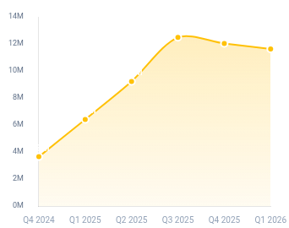
HIGHLIGHTS
DIGITAL TRANSFORMATION
FUTURE LEADERSHIP
DIGITIZED SERVICES
Ensuring seamless and secure implementation to deliver critical projects on-time
Wafa Bamatraf
Business Intelligence (BI)
Strategic Dashboard & Reports
High Impact
AI Value Creation
Smart Response
I&TF
Planned Outage
DP
Value Realization (Oct 2024 - Mar 2026)
Resolves notifications during peak demand (irregular weather). reducing refresh time by ~27% and enabling near real-time visibility
Tracks SAIDI/SAIFI performance + MDG utilization.
56.9
Million
Service Transformation Model (STM)
I&TF
MD Dashboard (Water Gen. & Storage)
I&TF
AED
Team formation with automation review and approval workflow (design→implementation).
Real-time Hassyan (IWP) visibility for executive decisions in Daily statistics Dashboard.
Cumulative Savings Achieved
Copilot Dashboard
I&TF
Billing
DM Housing fee & Sewerage charges
Copilot Adoption Suite
Daily AI adoption insights + training ROI tracking.
enhanced visibility & operational efficiency through six automated reports for Housing Fee and Sewerage charges
Tracking AI tool usage across Microsoft 365 applications.
Smart Service Solutions (SSS) Dashboard
I&TF
Driving productivity across divisions
Identifies and displays Service & General Inquiries statistics.
Operational Excellence
Modernization
System Availability (BI Services)
100%
Real-time Architecture
Streaming & Event-Driven Platform
Mu'asherat KPI Compliance
100%
Enables Near Real-Time Dashboards
Data Ingestion (External/DDA)
100%
For 2 Dashboards
Example: DEWA SLA Services
Intelligent Automation (Power Automate)
Service Requests Resolved
160+
Delivers immediate insights & fully automated process start to end for 5 Dashboards
100% SLA
Notes:
Copilot cost saving:
Productivity Value = Total Number of Interactions * Hours Saved per Interaction * Per Hour Rate.
The Per Hour Rate is 353 AED, as provided by the AI team. This formula has been discussed and acknowledged by the AI team.
Strategic Dashboard Impact:
1. Smart Response Dashboard This dashboard provides all technical notifications received/attended related to electricity/water interruption or any failure in the network I&TF , Water & Civil. Enhanced dashboard performance through SAP and Fabric integration, reducing refresh time by ~27% and enabling near real-time visibility.
Supports faster response and improved operational decision-making for critical network incidents. From 30 minutes to 22 minutes
2. STM Portal (Dashboard) I&TF Experience Team formation with automation review and approval workflow - Journey Portfolio Management to manage and document service catalogue, customer segmentation, delivery channels, process maps, journeys maps, baseline, etc. - Improvement cycle Management to view, manage, and document improvement initiatives/programs across all stages (design, development & testing, and implementation)I&TF
Benefits:
- Automating Service Transformatie Management
- Eliminating Silo
- Improving Data Accuracy
I&TF Experience Management
3. CAIO Co-pilot dashboard The CAIO view will mirror the EVP view with enhancements relevant to AI governance.
The daily filter will allow deep operational insight into daily usage patterns, adoption spikes, training impact, and productivity gains.
The enhancement supports the broader AI adoption strategy I&TF – CAIO
4. SSS Dashboard - The Objective of the dashboard is to identify and the display the Service inquires and General Inquires statistics for a given time period for SSS (Smart Service Solution) I&TF
General Inquiry: Billing, Timing, Disconnection/Reconnection, Password Rest, etc.
Service Inquiry: Activation of E/W, EV Green Charger, Bill Payment, etc.
5. Planned Outage Analysis dashboard-DSSR (Enhancement)Dashboard provides Zone wise Scheduled Outage statistics along with Planned SAIDI & SAIFI, MDG Utilization and Status of NSOP DefectsDP - Distribution Control Center
6. MD Dashboard Enhancement - GD Water & Water Storage. This dashboard provides real-time data from Hassan reservoirs and Hassyan (IWP), ensuring comprehensive visibility of water storage in city reservoir, and water supply. These enhancements to be reflected in MD Dashboard Power BI Application (Web & smart office App) and MD Dashboard Desktop application in MD office. Generation
7. DM Housing fee & Sewerage charges reports: The development of six operational reports covering Housing Fee and Sewerage charges. The solution enhances monthly reporting, billing transparency, and eligibility identification using existing Sales Statistics data sources.
Below each for Housing and Sewerage:
1. DM Housing Fee Monthly Statement
2. Housing Fee Billing Report
3. Housing Fee Eligible Accounts
4. DM Sewerage Fee Monthly Statement
5. Sewerage Fee Billing Report
6. Sewerage Fee Eligible Accounts Billing Services
Intelligence automation (Power Automate):
Innovation Portfolio Dashboards
Cybersecurity Awareness Statistics Dashboards
OneID Dashboards
Sailpoint Dashboards
TP/OT Cybersecurity Dashboards
Fully automated, real-time dashboard updates are enabled through Power Automate, eliminating the need for scheduled refreshes and reducing operational overhead.
Executives receive timely insights and automated notifications, enabling faster decision-making with always up-to-date and reliable data

Slide 20


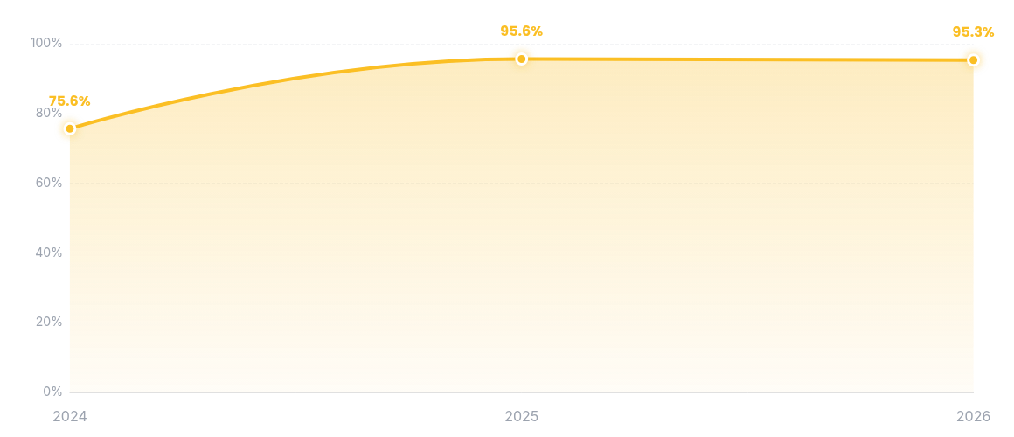
HIGHLIGHTS
DIGITAL TRANSFORMATION
FUTURE LEADERSHIP
Automation Status
DIGITIZED SERVICES
Ensuring seamless and secure implementation to deliver critical projects on-time
Wafa Bamatraf
DATA QUALITY
DATA SHARING
2025 2026 (Q1)
As of 2026 Q1
Completed
Sustained
PROGRAM
Quality Score
92%
Asset Management TP
Water & Electricity Consumption (2025 Q4)
94%
Data Quality Scores (2024-2026 Q1)
Asset Management DP
Ingestion
API
Datasets
3
Attributes
25
98%
95%
95%
SHAMS Dubai
100%
75%
93%
80%
AMI Electricity & Water
Completed
60%
98%
EV Green charger
40%
IRENA & Renewable Energy Data (2025)
Data Quality is assessed per program to ensure sustained progress, reinforcing accountability and enabling more accurate reporting, analytics, and operational excellence
20%
Datasets
9
Attributes
70
Ingestion
Bulk
2024
2025
2026
Notes:
PoC data governance workflow approval

Slide 21
THANK YOU

